Slide 1

Blog Website Development
Project
This project creates a functional blog website using HTML, CSS, and
JavaScript, focusing on an intuitive user experience. This presentation
will cover the project's overview, technical implementation, development
process, challenges, and future enhancements.

Slide 2

Core Technologies & Key Features
HTML5
CSS3
JavaScript
Structural foundation
Visual components and styling
Dynamic functionality

Slide 3

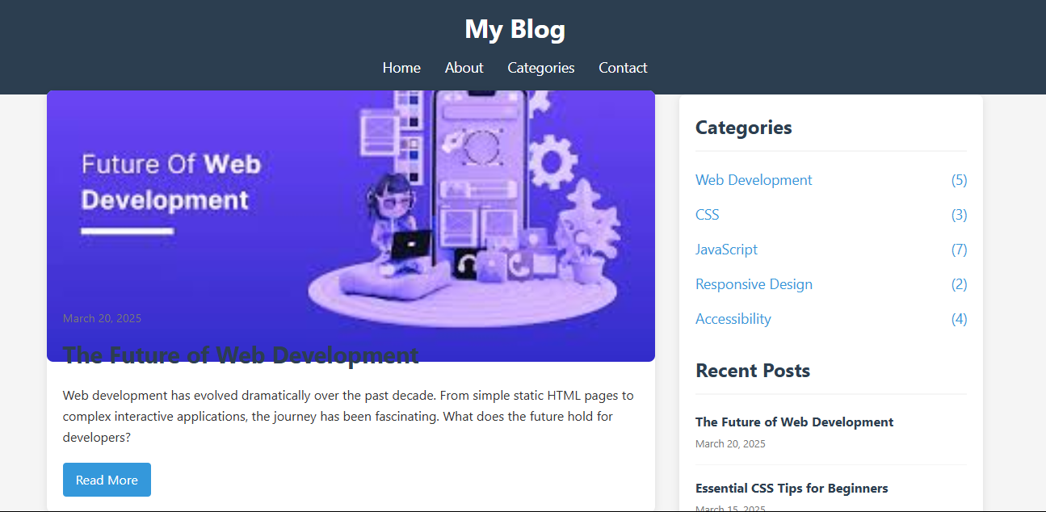
User Interface Components
Responsive
Nav Bar
Featured
Posts
Article Grid
Organized
display of
articles
Easy navigation
across devices
Highlights
important
content
Social Footer
Links to social
platforms

Slide 4
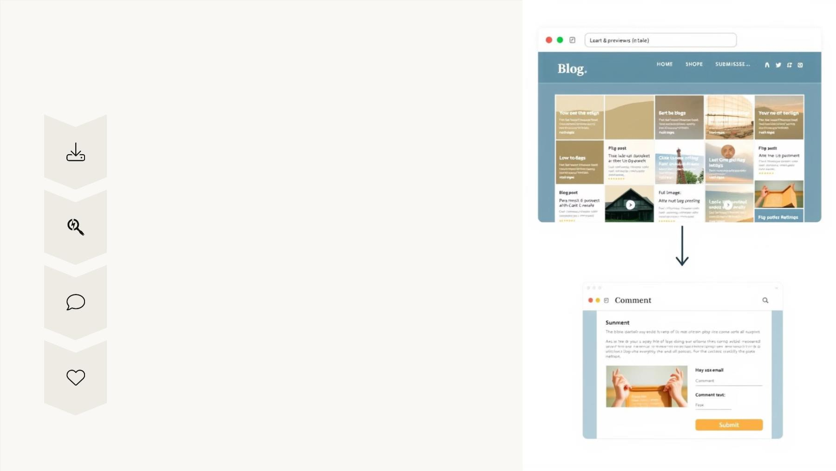
Functional Elements
Dynamic Loading
Posts load on demand
Article Search
Easy to find specific content
Comment Form
Interactive feedback section
Like Button
Simple user interaction

Slide 5
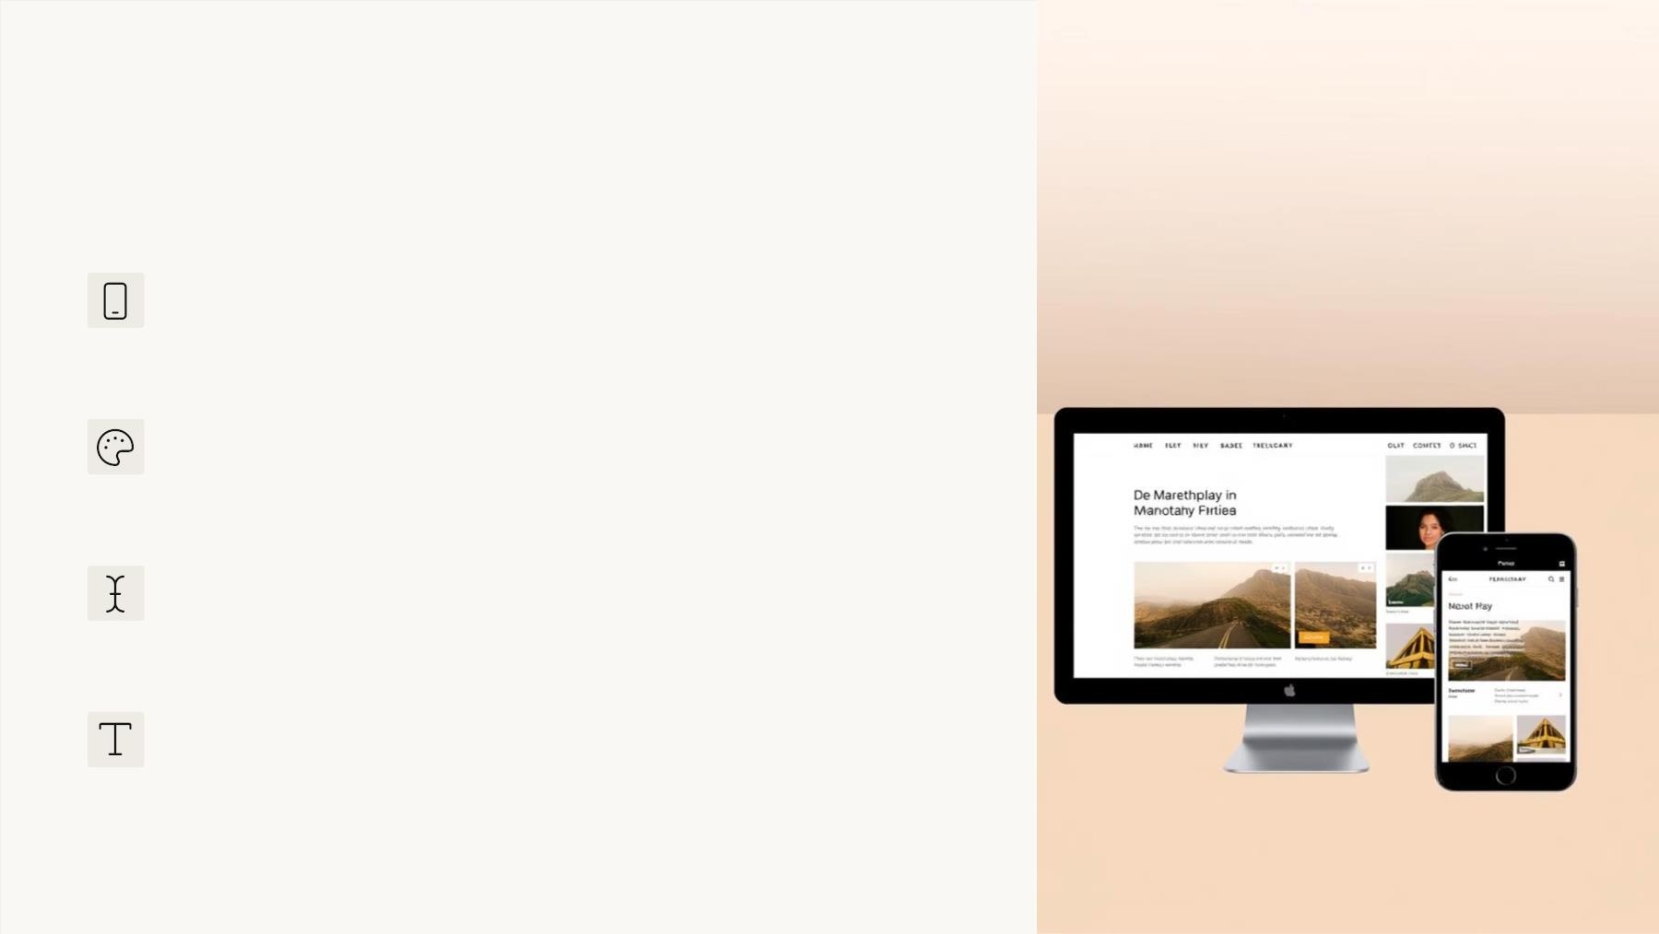
Design and Approach
Mobile-First Design
Responsive across all devices
Consistent Theme
A well-defined color scheme
Hover States
Interactive user feedback
Readable Typography
Easy to read for all users

Slide 6
Challenges and Solutions
Responsive Design
Consistency across devices
Mobile-first approach
Dynamic Content
Browser Compatibility
Feature consistency
Interactive element management
JavaScript data model
Feature detection & polyfills

Slide 7

Testing and Validation
Manual Testing
1
2
3
Cross-Browser
Across multiple devices
Ensuring Compatibility
Accessibility
User Experience
Audits and validation
4
Usability testing

Slide 8

Future Enhancements
CMS Integration
User Authentication
Database

